Slide 1
Moving Toward the Transcendent
Jim Slouffman, Artist
This slide show offers a retrospective of
A Virtual Art Exhibit featured in the JACO Art Gallery
Fall/Winter 2022

Slide 2
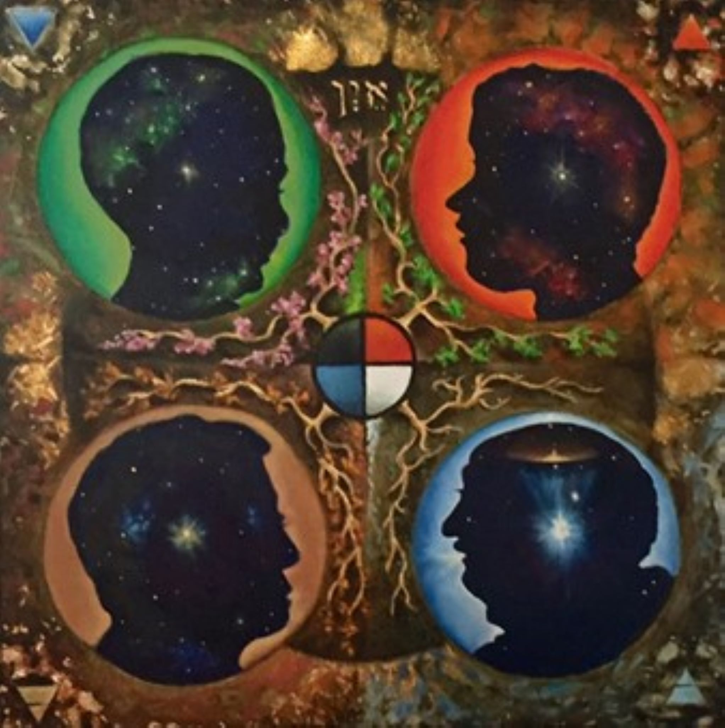
The Four Seasons of Life
This painting depicts four stages of life from infancy top left to old age bottom right. The center mandala connects all the stages with the Native American medicine wheel in the center. In the center of each male silhouette burns a star. This star is the goal of wholeness. It burns brighter with each stage as consciousness expands.

