Slide 1
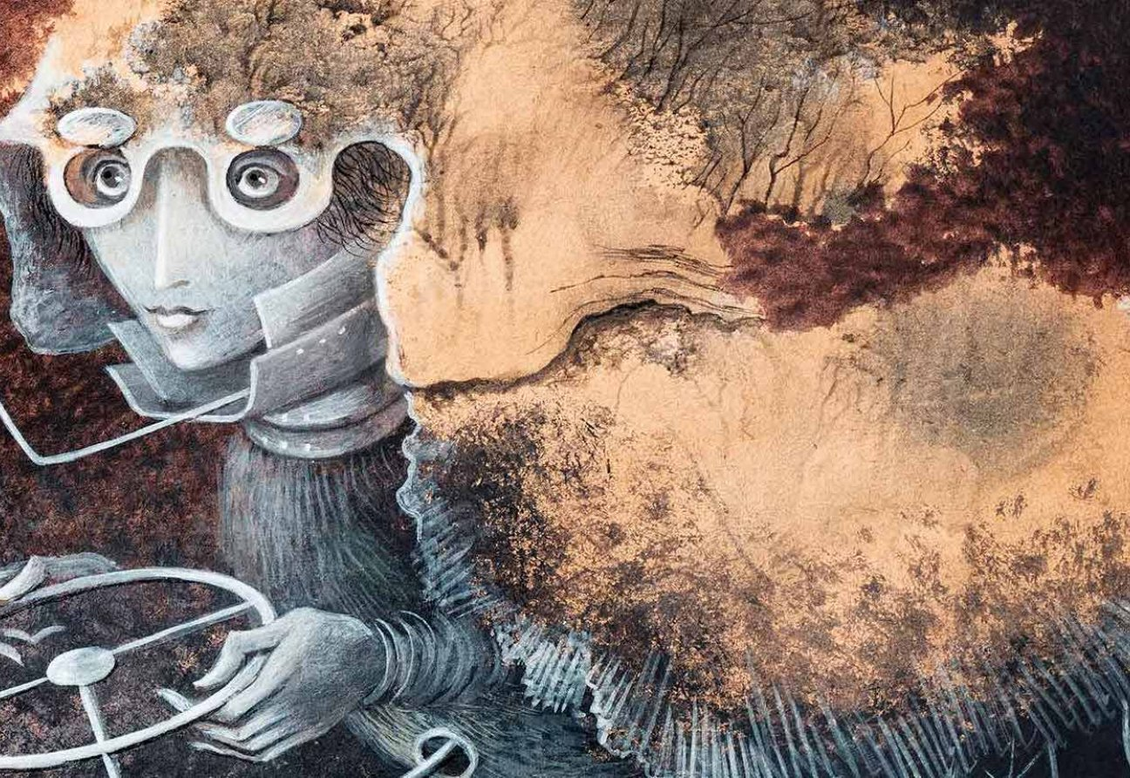
Love, Power, and the Paintings of Remedios Varo

Slide 2
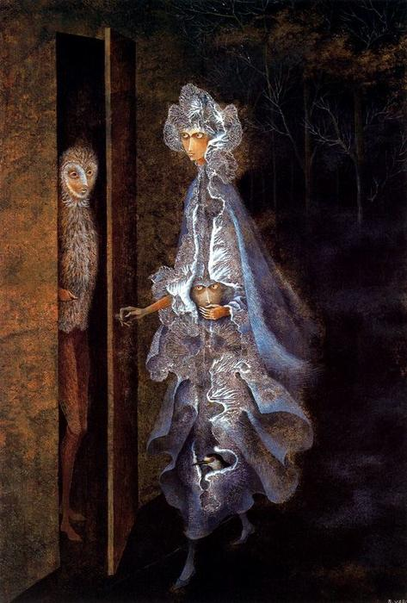
Notes:
The Encounter

Slide 3
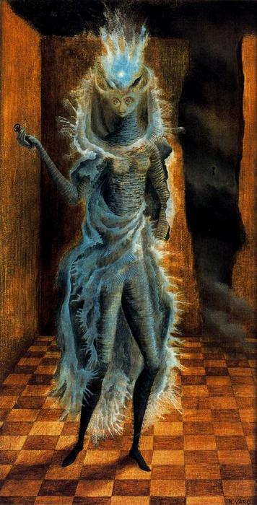
Notes:
Minotaur

Slide 4
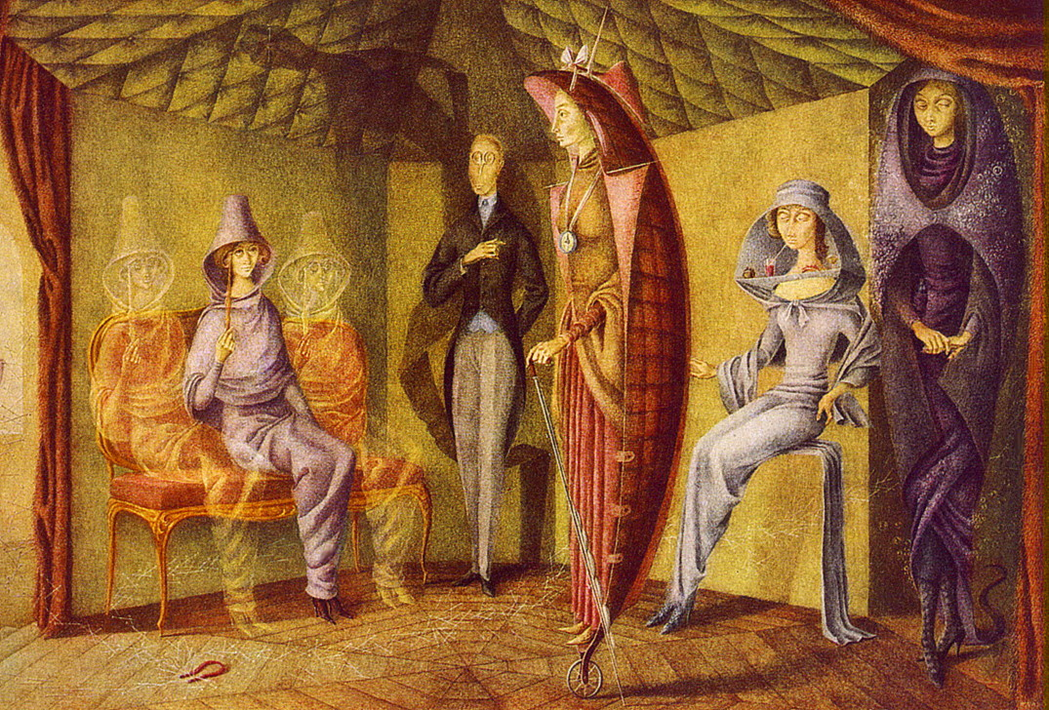
Notes:
Women’s Tailor

Slide 5
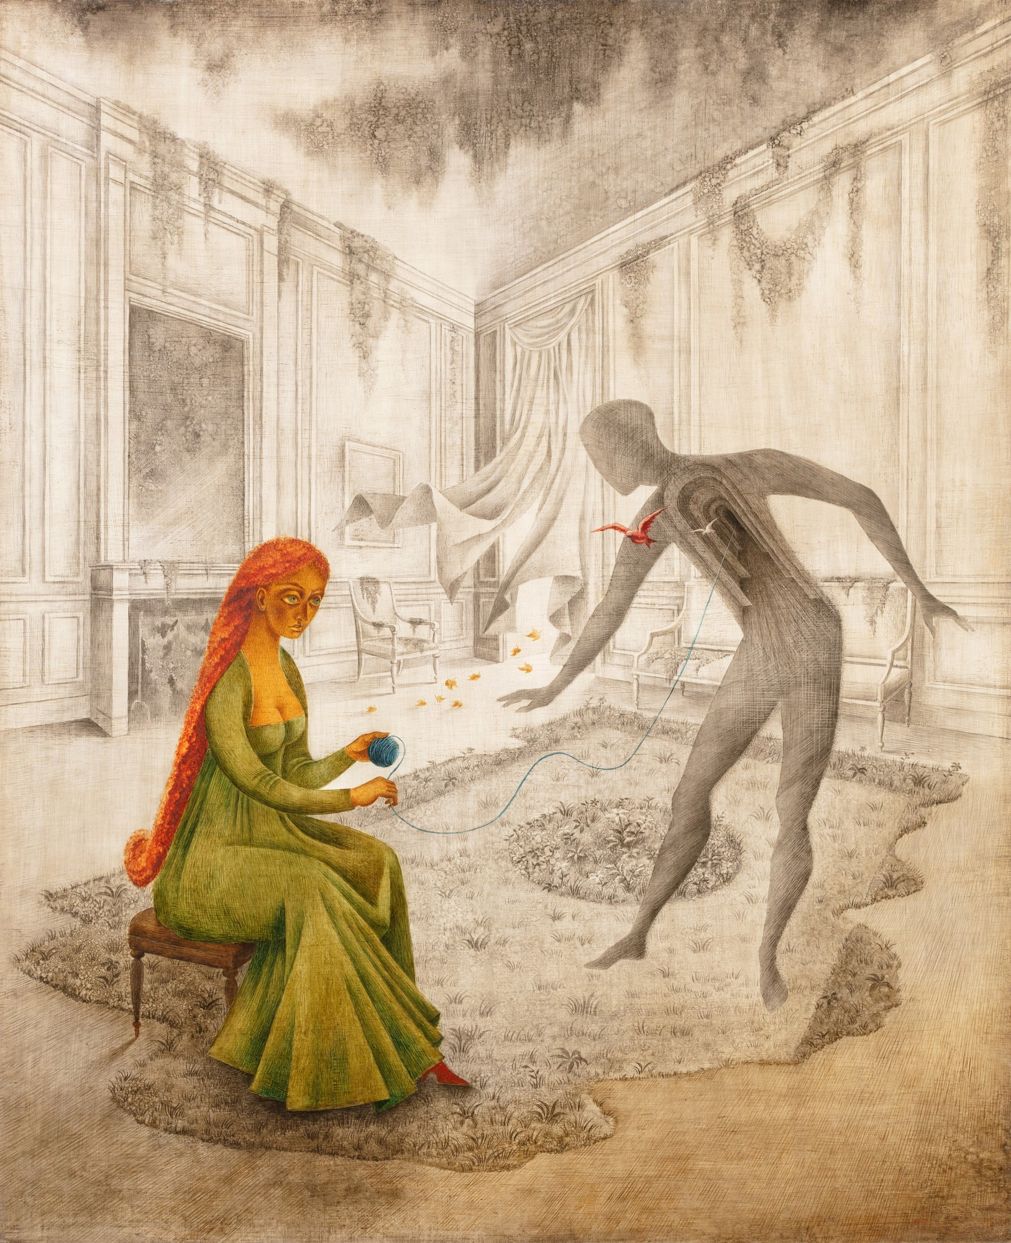
Notes:
Dead Leaves

Slide 6
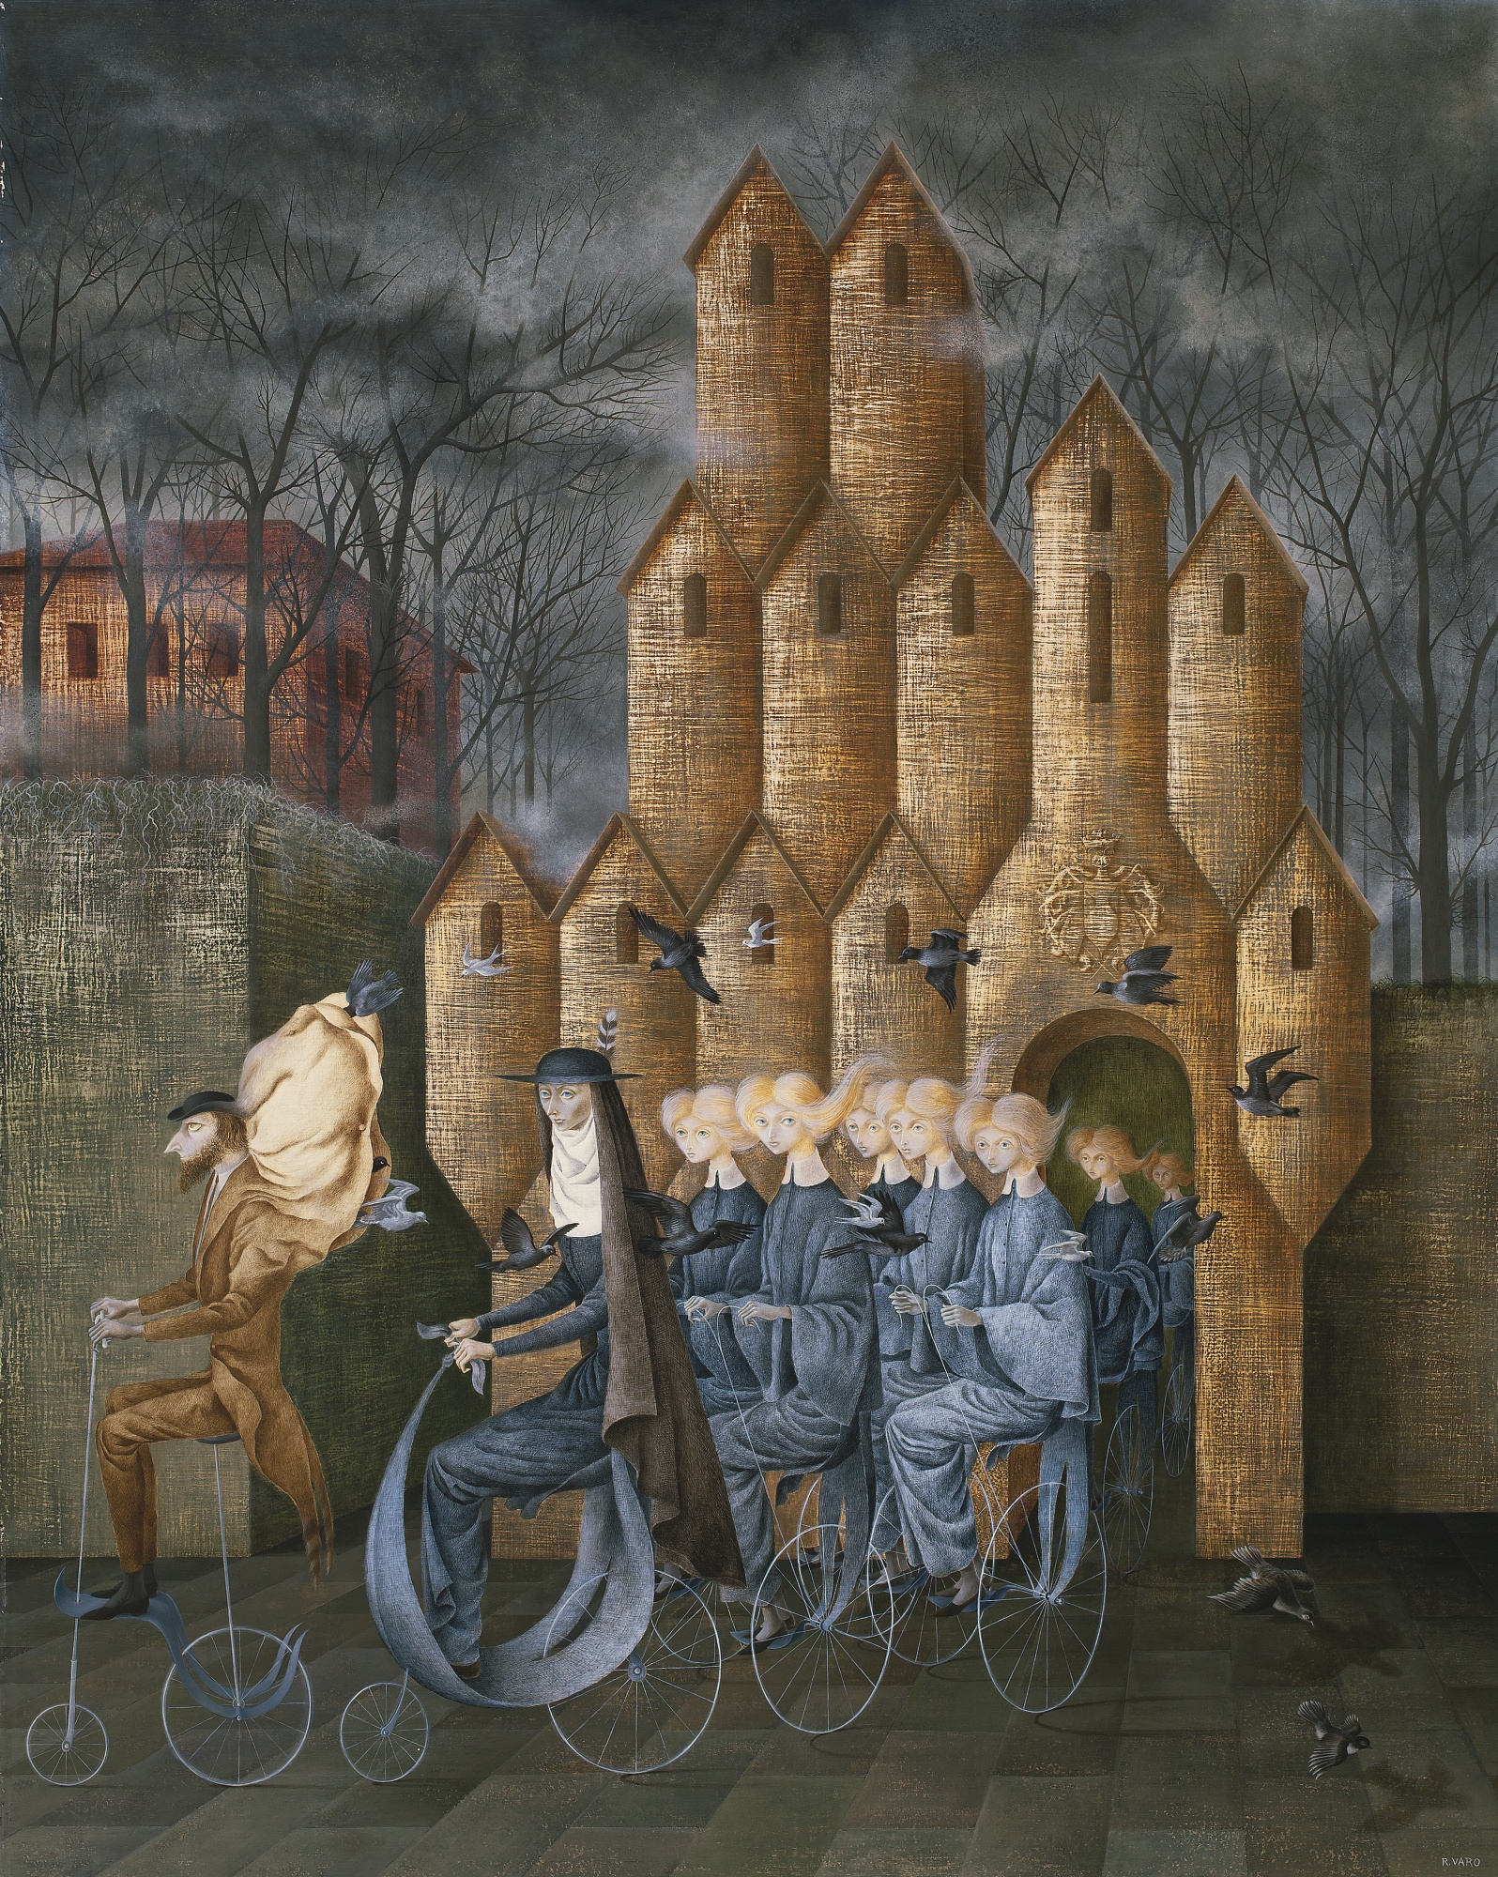
Notes:
Toward the Tower (1st painting in a triptych that includes Embroidering the Earth’s Mantle)

Slide 7
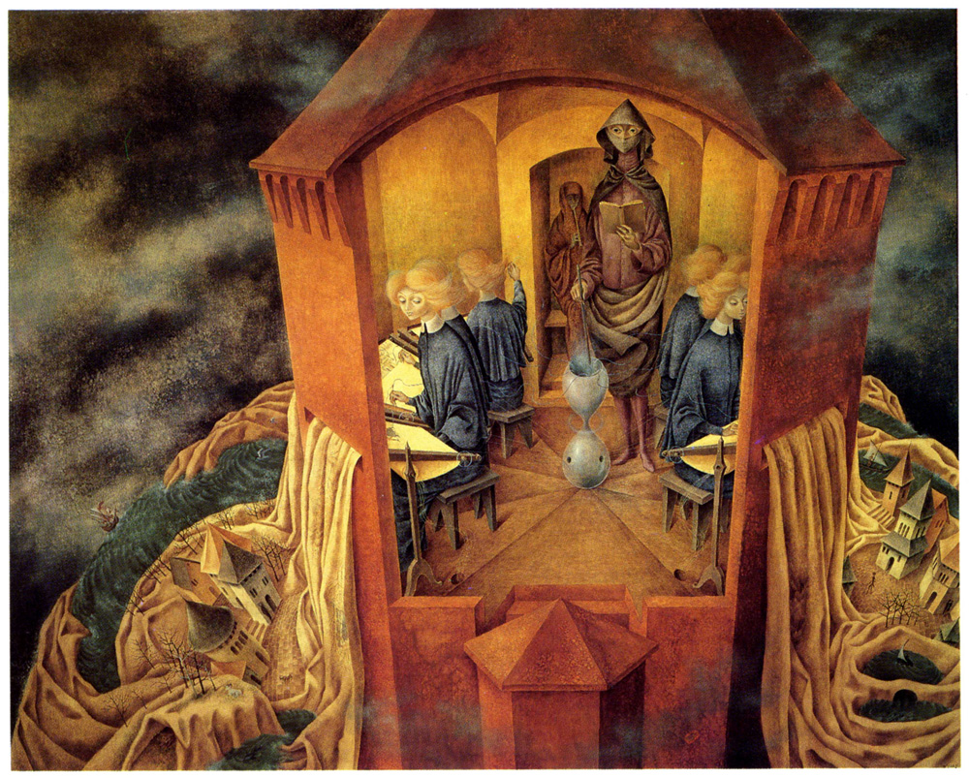
Notes:
Embroidering the Earth’s Mantle

Slide 8
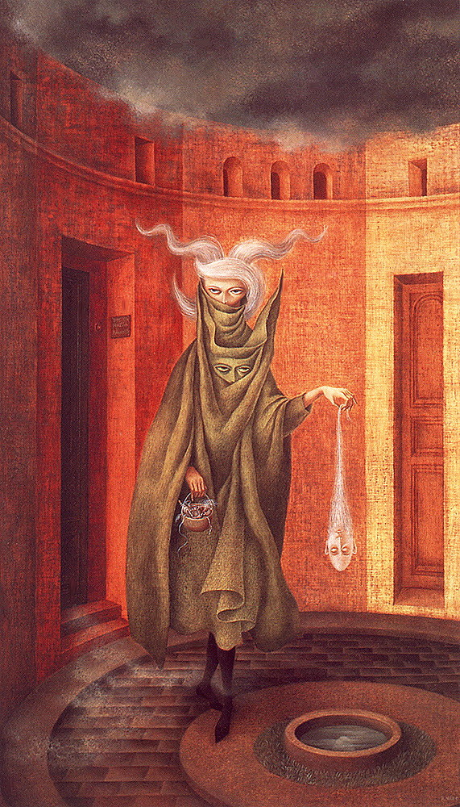
Notes:
Woman Leaving the Psychoanalyst

Slide 9
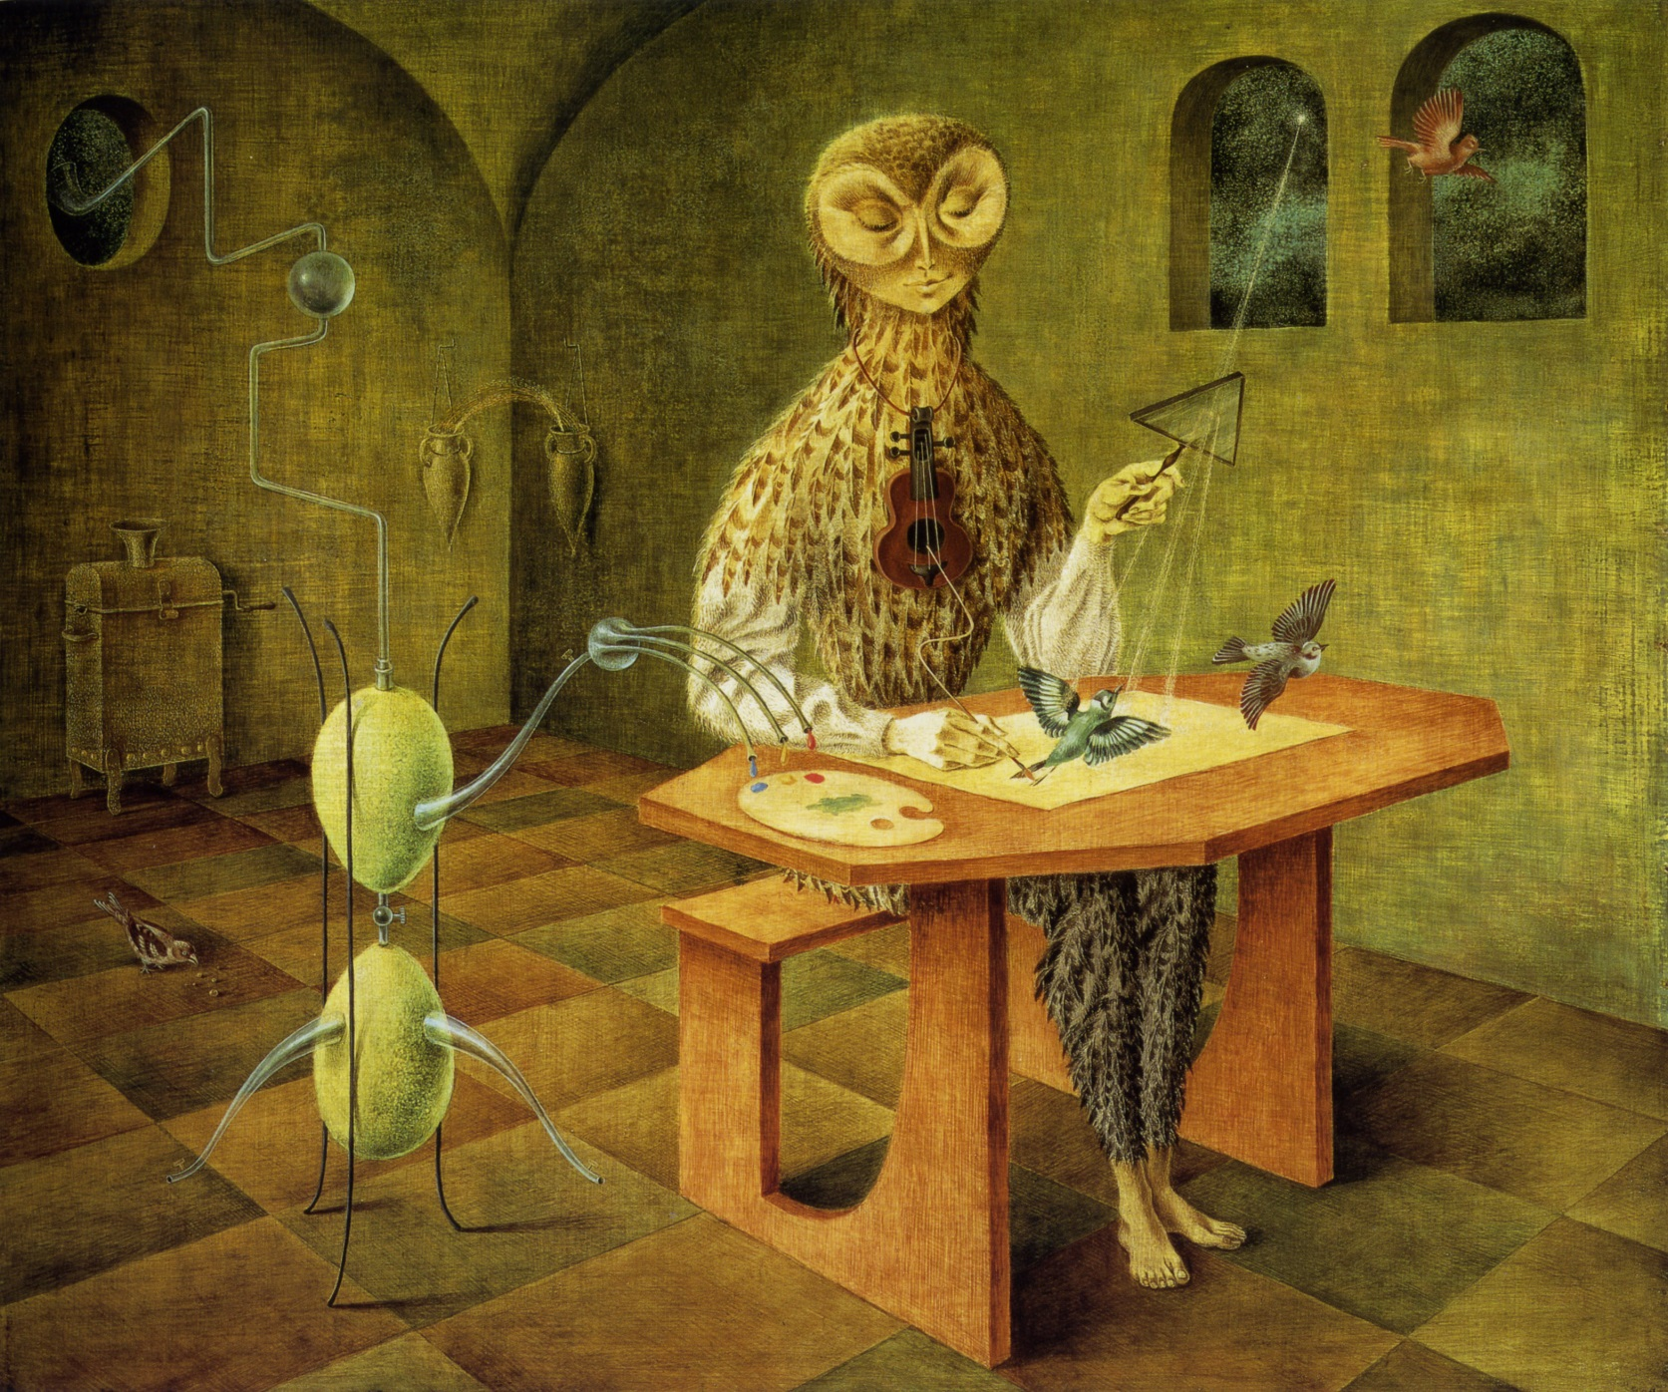
Notes:
Creation of the Birds

Slide 10
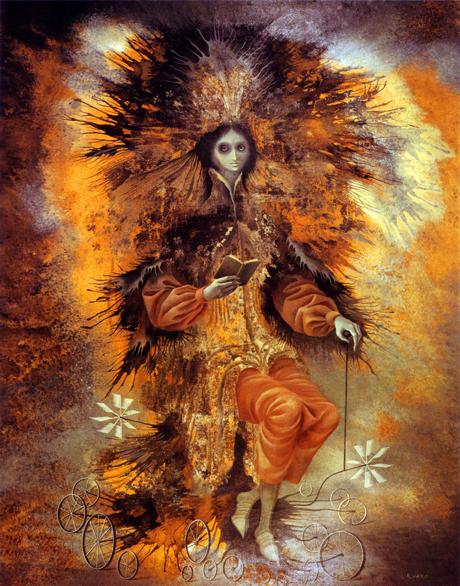
Notes:
The Sign of the Painter

Slide 11
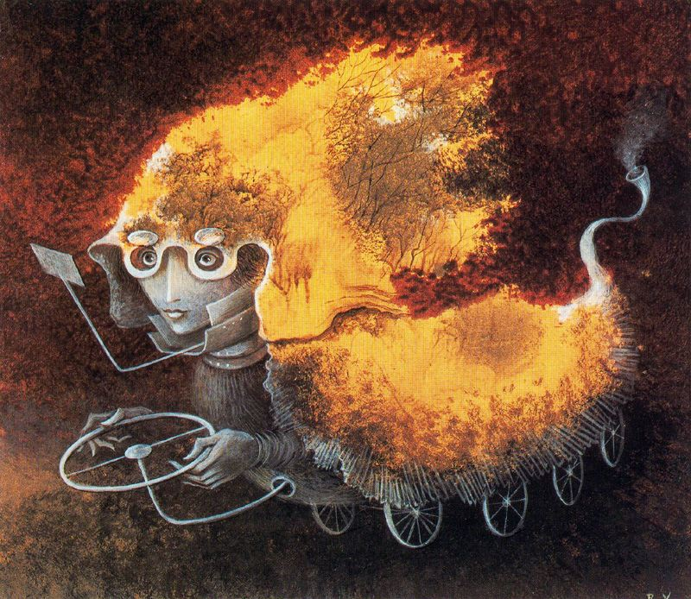
Notes:
As the Volante, 1962

Slide 12
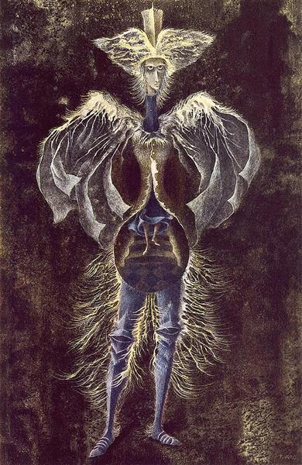
Notes:
Personage ( what a lovely image of self-discovery)

Slide 13
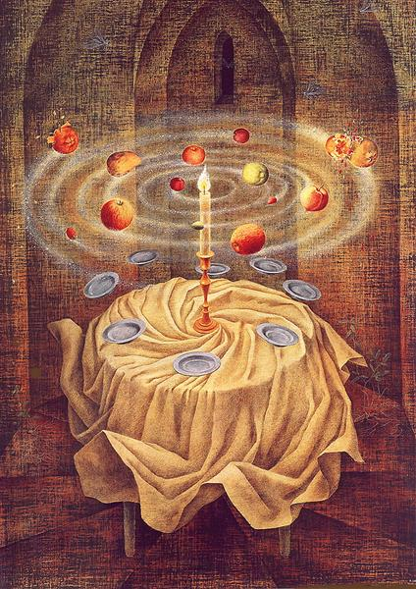
Notes:
Still Life Reviving (the last painting Varo completed before her death by heart attack in October 1963).

Slide 14
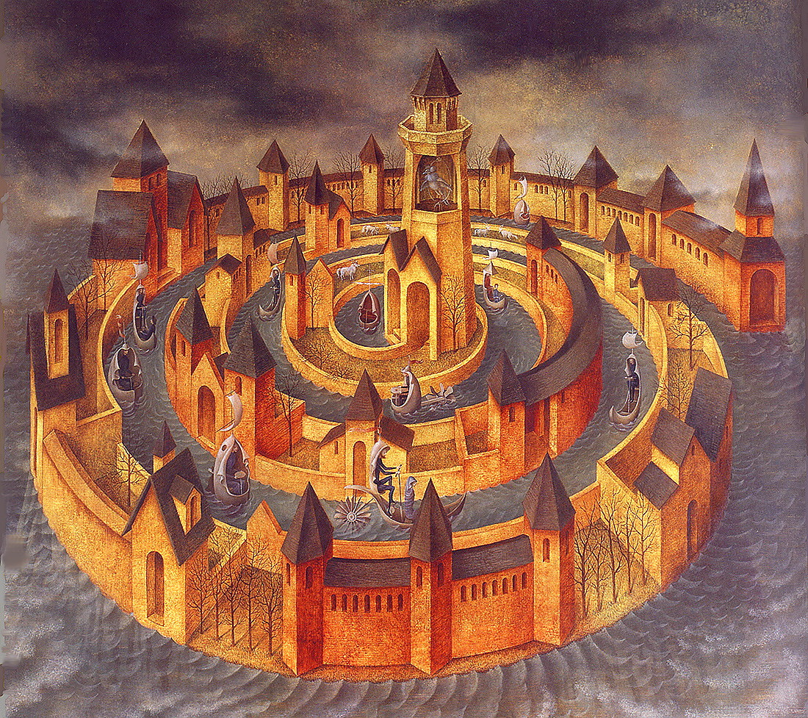
Notes:
Trasitoen Espiral (Spiral Transit)

